Slide 1
Different Models of Governing Systems
Mukul Anand

Slide 2
Introduction
What is a Governing System?
A governing system is the way a country or place is run. It decides who has the power to make rules and how decisions are made for everyone.
Notes:
Insert a map of your country.

Slide 3
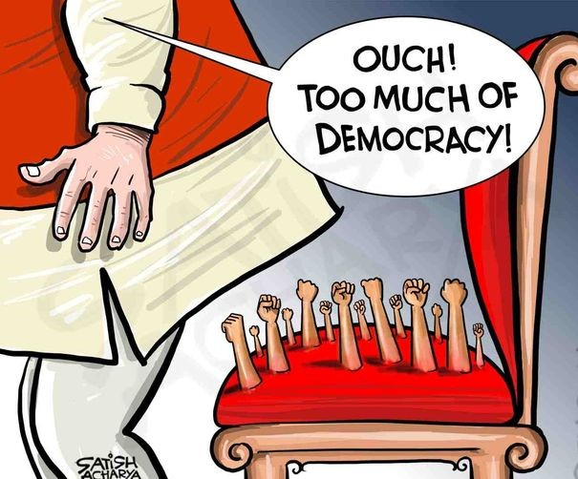
Democracy
In a democracy, people have the power. They vote to choose their leaders and make decisions.
Examples: USA, India
Key Features:
Free and fair elections
Majority rule, but with protection for minorities
Freedom of speech and rights
Notes:
Insert a picture of one of the geographic features of your country.

Slide 4
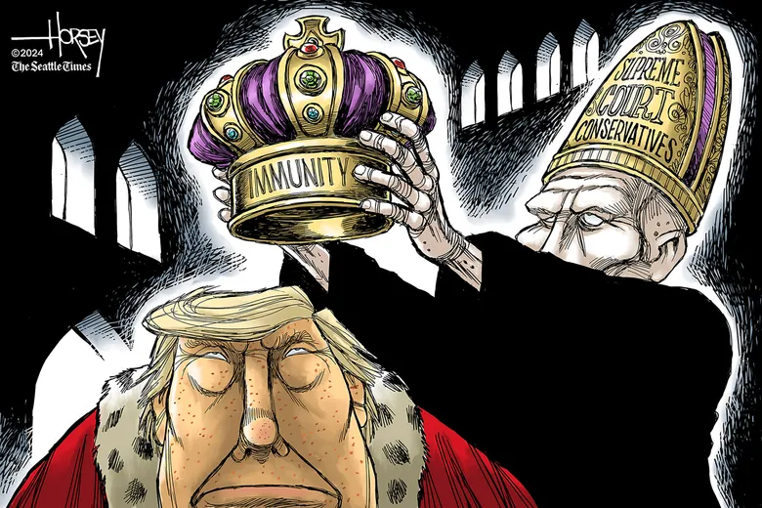
Monarchy
A monarchy is ruled by a king or queen. The power is passed down through family.
Examples: United Kingdom, Saudi ArabiaKey
Key Features:
The king or queen is the leader
In some places, they have all the power (absolute monarchy), while in others they share it with elected officials (constitutional monarchy)
Notes:
Insert a picture illustrating a season in your country.

Slide 5
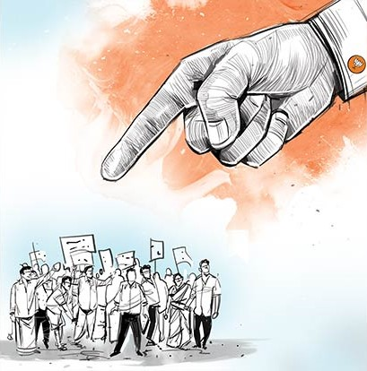
Dictatorship
In a dictatorship, one person has all the power, and they usually take control by force.
Examples: North Korea, Syria
Key Features:
No free elections
Little or no freedom for the people
The leader makes all decisions
Notes:
Insert a picture of an animal and or plant found in your country.

Slide 6
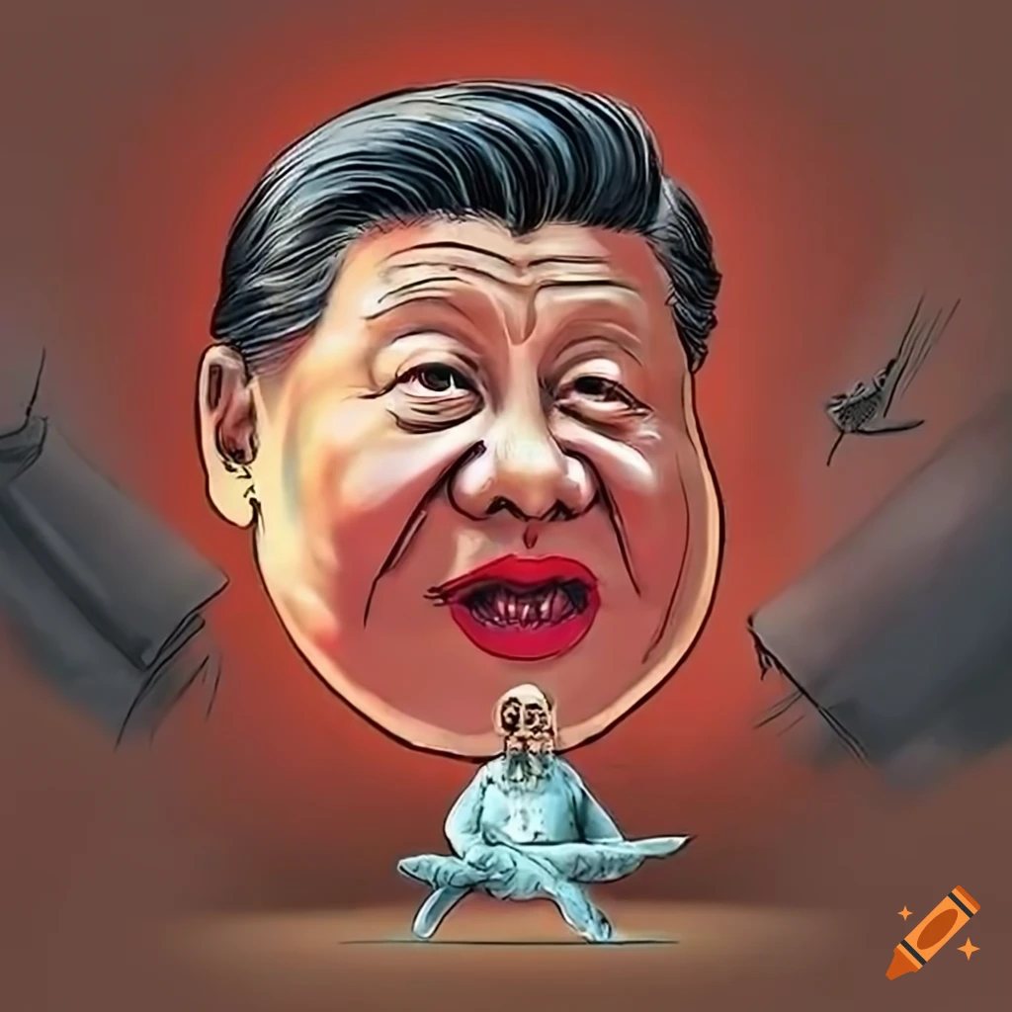
Communism
In communism, the government controls everything, and there is no private property. The goal is for everyone to be equal.
Examples: China, Cuba
Key Features:
Government owns all land and businesses
Everyone gets the same amount of resources
Notes:
Add key points in the history of your country to the timeline.

Slide 7

Republic
A republic is a type of democracy where the people elect representatives to make decisions for them.
Examples: USA, Brazil
Key Features:
Leaders are elected by the people
Rules are based on a constitution
Notes:
Insert a picture illustrating a custom or tradition here.

Slide 8

Theocracy
A theocracy is a government run by religious leaders, and laws are based on religious beliefs.
Examples: Iran, Vatican City
Key Features:
Religious leaders have the power
Laws follow religious texts
Notes:
Insert a picture of the head leader of your country.

Slide 9
Conclusion
Different governing systems work in different ways. Each has its own strengths and challenges. The best system depends on the values of the people and the country.
Notes:
Insert a picture that illustrates some part of your country’s economy.

Slide 10
Thank you
Notes:
Insert a picture of one of the points of interest for your country.

